Slide 1


ONLINE ADVERTISING FRAUD DETECTION AND ANALYTICS SYSTEM
CSA1609: Data Warehousing and Data Mining
Presented by:
K.HARIKA MYTHREYI (192311377)
G.MADHULATHA (192311295)
HEMANTH REDDY (192411057)

Slide 2
Introduction
Online Advertising Fraud Detection and Analytics System is used to identify and prevent fraud in online advertisements.
It helps detect fake clicks, bot traffic, and invalid ad impressions that can waste advertising budgets.
The system analyses user activities such as clicks, browsing patterns, and device information to find suspicious behaviour.
It provides reports and analytics to help advertisers understand the performance of their advertising campaigns.
The system improves advertising efficiency, reduces financial losses, and helps businesses make better marketing decisions.

Slide 3
Problem Statement
Online advertising platforms face significant losses due to fake clicks, bot traffic, and fake activities.
It is difficult for advertisers to identify whether ad clicks are generated by genuine users or automated bots.
Fraudulent clicks can increase advertising costs without generating real customer engagement.
Existing systems may not provide accurate analysis and timely detection of suspicious activities.
Therefore, there is a need for a system that can detect advertising fraud and provide useful analytics to improve campaign effectiveness and reduce financial losses.

Slide 4
Proposed Methodology
Data Collection – Gather online advertising data such as clicks, impressions, and user activities.
Data Preprocessing – Clean and organize the collected data for analysis.
Pattern Analysis – Identify unusual or suspicious advertising behaviors.
Fraud Detection – Detect and classify fraudulent advertising activities.
Reporting & Visualization – Generate reports and dashboards to monitor fraud trends and support decision-making.

Slide 5
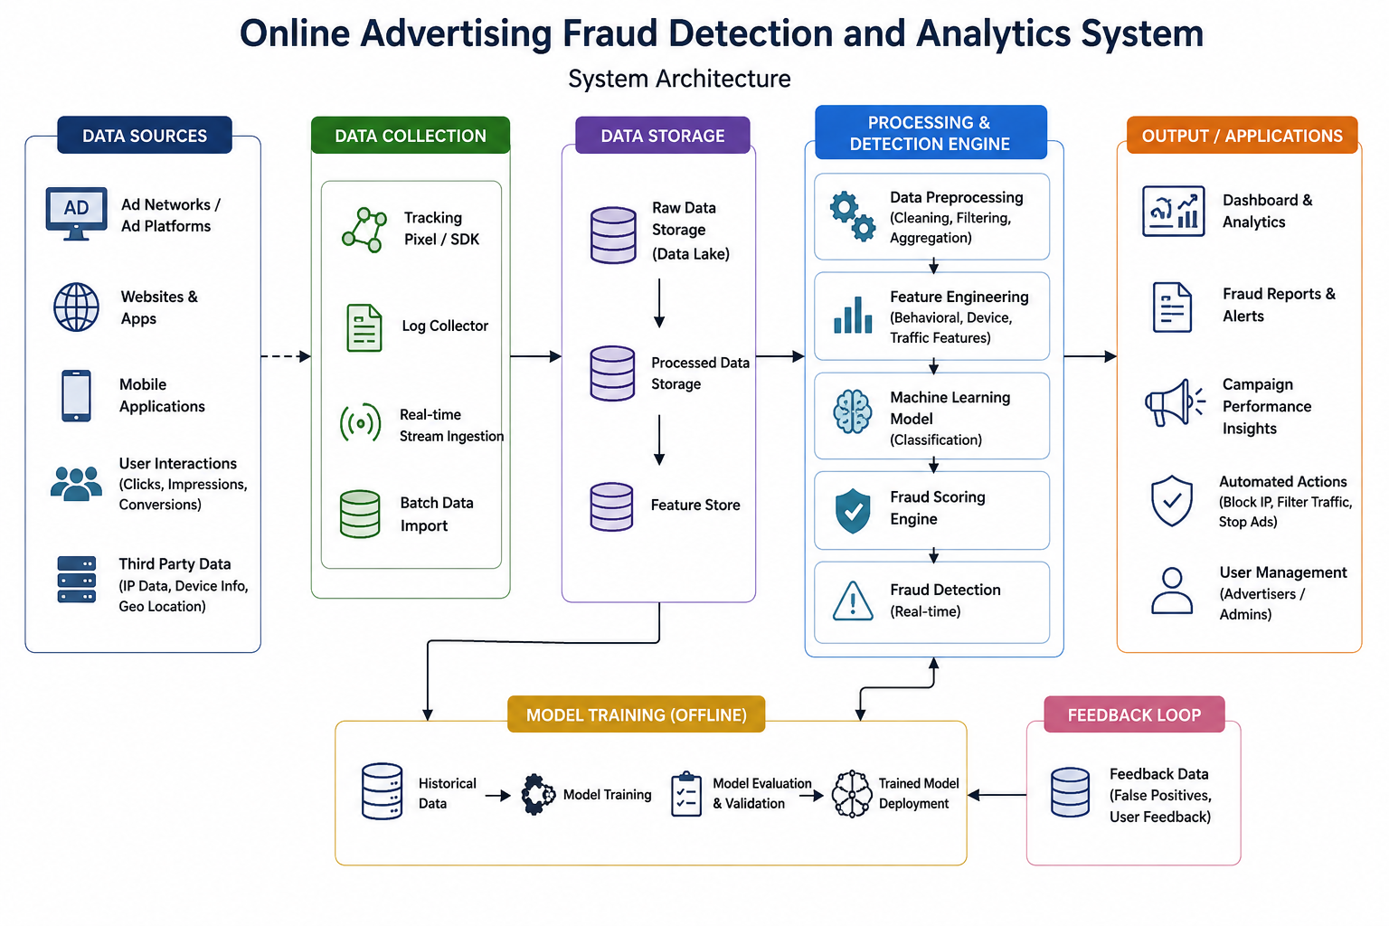
Architecture Diagram

Slide 6

Module 1
Advertisement Data Collection
Collect advertisement click information from users.
Gather data on advertisement impressions and views.
Track user interactions with online advertisements.
Record device, browser, and location details.
Store the collected data for further analysis and reporting

Slide 7
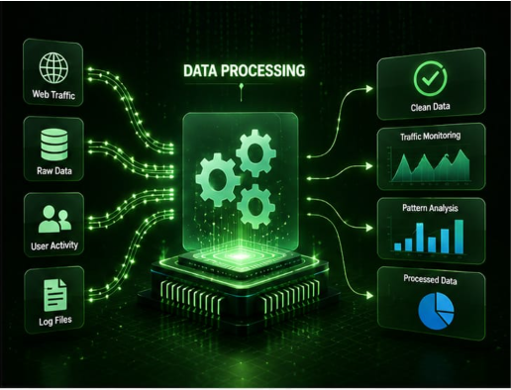
Module 2
Data Processing and Traffic Monitoring
Clean the collected advertisement data by removing duplicate and incomplete records.
Organize and format the data for easy analysis.
Monitor advertisement traffic from different sources.
Analyze user activity and traffic patterns.
Prepare the processed data for fraud detection and reporting.

Slide 8
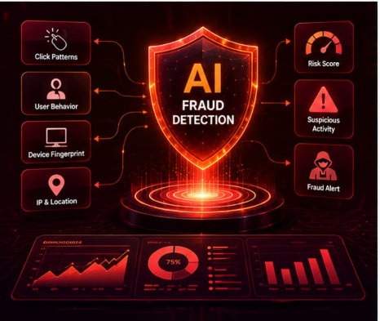
Module 3
Fraud Detection and Analysis
Identify unusual advertisement click patterns.
Detect suspicious user and traffic activities.
Analyze repeated clicks and abnormal behaviors.
Classify activities as genuine or potentially fraudulent.
Generate fraud detection results for further evaluation.

Slide 9
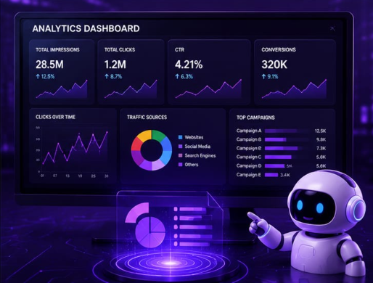
Module 4
Analytics and Reporting
Generate reports on advertisement performance and fraud activities.
Display fraud statistics using charts and graphs.
Monitor trends and patterns in advertising data.
Provide insights to improve advertising effectiveness.
Present results through an interactive dashboard for decision-making.

Slide 10
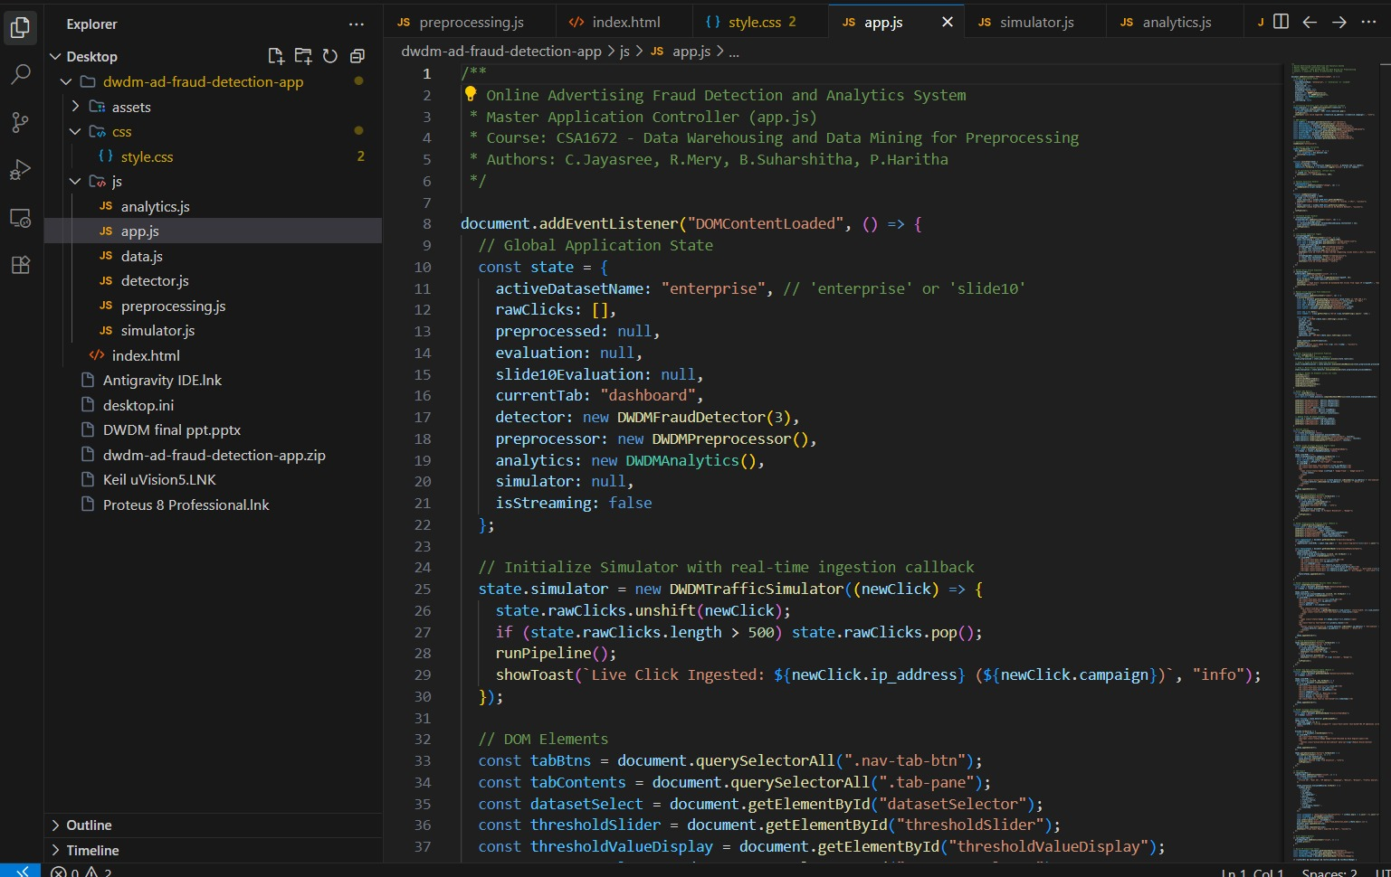
IMPLEMENTATION

Slide 11
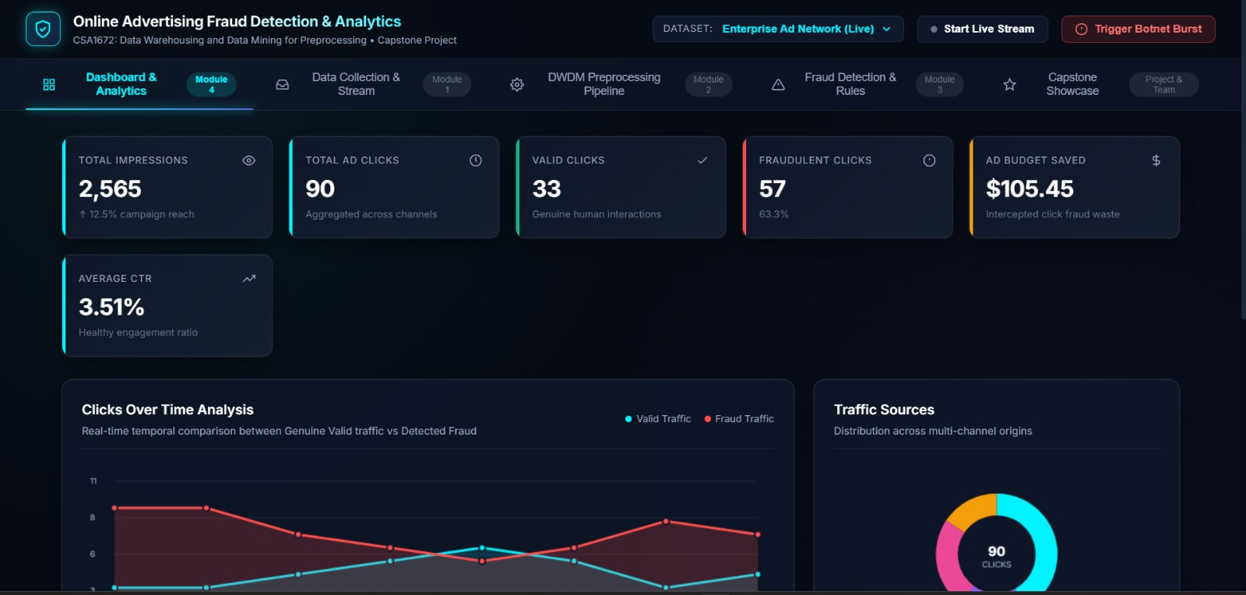
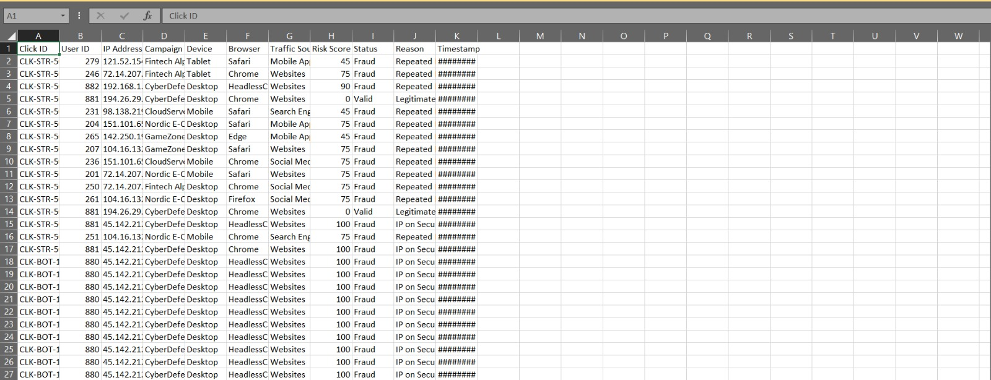
OUTPUT

Slide 12
Results & Discussion
The system successfully analysed advertisement click data and identified suspicious IP addresses with unusually high click counts.
Fraudulent clicks were detected using predefined rules, helping to distinguish between valid and invalid user activities.
The analytics report provided a clear summary of total clicks, valid clicks, and fraud clicks, making campaign monitoring easier.
The results showed that repeated clicks from the same IP address can indicate potential advertising fraud and unnecessary advertising costs.
Overall, the system improved the accuracy of ad performance analysis and helped advertisers make better decisions by reducing the impact of fraudulent activities.

Slide 13
Future Scope
The system can be enhanced using advanced Machine Learning and AI algorithms for more accurate fraud detection.
It can be integrated with real-time monitoring systems to detect and block fraudulent clicks instantly.
The system can support multiple advertising platforms such as Google Ads, Facebook Ads, and Instagram Ads.
Advanced data visualization dashboards can be added to provide better insights into advertising performance and fraud trends.
The system can be expanded to detect other types of fraud, such as impression fraud, bot traffic, and fake conversions.

Slide 14
Conclusion
The system successfully detects fraudulent activities in online advertisements using click data analysis.
It helps advertisers identify fake clicks and suspicious user behavior, reducing unnecessary advertising costs.
The analytics feature provides useful insights into advertisement performance and user engagement.
The system improves the accuracy, transparency, and reliability of digital advertising campaigns.
Overall, it is an effective tool for fraud prevention and better decision-making in online advertising.

Slide 15
Thank You!

